Slide 1
The Literature Review
A must-have for any publication-quality paper

Slide 2
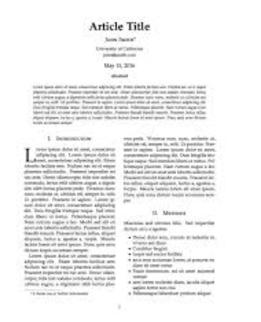
Overall Structure of a Paper
Title
Abstract
Author/Affiliation
(summary of the paper)
Introduction
Literature
(“Previous Work” or similar title)

Slide 3
Literature Review
Usually comes early in the paper
One or two-sentence definition of the topic
Identifies the origin of the topic
Identifies key milestones in the history of the topic
Identifies people with key contributions
Gives the current “state of the art”
Positions your work relative to the overall history of the topic

Slide 4
Literature Review
Usually chronological in order (oldest references first)
Use only primary sources (more on this later)
Usually one page, two at most (unless you are doing a survey paper)
Avoid lengthy descriptions or explanations (that comes later in your paper)

Slide 5
Literature Review
Every publication has its own format with regard to how you cite a reference. You must follow the publication’s guidelines.
Sometimes, this will be in APA or MLA format (like you may have used in college) but often it will be a different format probably unique to that publication

Slide 6
Literature Review – typical styles
Einstein noted the photoelectric effect depended on the wavelength, and hence the frequency of the light [4].
Some publications number the references sequentially and place the number at the end of the sentence. In this style, the References section lists citations in the order in which they appear in the paper.

Slide 7
Literature Review – typical styles
(Einstein, 1905) noted the photoelectric effect depended on the wavelength, and hence the frequency of the light.
You can use the author(s) name and year of the publication as a noun in your sentence (but you don’t have to, it can come at the end of a sentence too if it reads better that way).
This style makes it easy to scan for recognizable names and references. For example, everyone knowledgeable about it will recognize (Shannon, 48) as the seminal paper on information theory.

Slide 8
Literature Review – typical styles
The References section lists the citations alphabetically:
Christensen, C.M. (1997). The Innovator’s Dilemma, Harvard Business Review Press, 1997.
Christensen, C.M., Hall, T., Dillon, K., Duncan, D.S. (2016). Competing Against Luck, Harper Collins, New York.
Dean, Douglas L., Hender, Jillian M., Rodgers, Thomas L., Santanen, Eric L., (2006). Identifying Quality, Novel, and Creative Ideas: Constructs and Scales for Idea Generation, Journal of the Association for Information Systems, Vol 7, No 10. October 2006.
Notice the format. Author last name, initials with dots, year of publication in parenthesis and then a period. Name of the book or volume in italics (but not the title of a chapter, article, or paper). Indent the second and third lines if it goes past one line.

Slide 9
Literature Review – typical styles
Amazon Mechanical Turk (2016). Internet site retrieved December 22, 2016 from https://www.mturk.com/mturk.
For a Web site, you must include the title of the page (along with the author if you know it) and the link to the specific page

Slide 10
Literature Review – typical styles
Carpenter, H. (2010). 25 Ways of Thinking About Innovation, Spigit, retrieved January 29, 2014, from http://www.spigit.com/blog/25-definitions-of-innovation/
This is an article from the Web. You must note when you last viewed the article and also the link.

Slide 11
The Literature Review
A must-have for any publication-quality paper

